Slide 1

A Hands-on Introduction to Neural Networks and Deep Learning with IBM Watson Studio
David Solomon
IBM Executive Architect and Senior Cloud and Cognitive Evangelist
Technical Evangelist Team

Slide 2





About Me
Focus / Passion
AI, Cognitive, Emerging Technology
Analytics
Data (Architecture, Modeling, Integration)
Cloud Service Architecture
Applying the above to real-world business problems
Education & Certification
M.S. Software Engineering
B.S, Physics
Data Mgmt, AI, Cloud, Docker, DevOps, …
David Solomon
Technical Evangelist, IBM
Proud Member of the IBM WolfPack
dsdlsolomo
@dlsolomo
Team-wolfpack

Slide 3
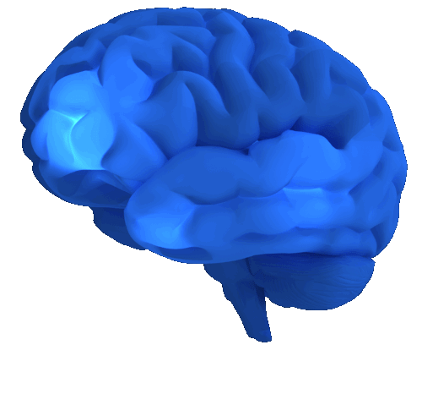
Deep Learning Introduction
Deep Learning is inspired by the human brain, it attempts to mimic the activity in layers of neurons in the human brain where thinking occurs.
Notes:
Deep learning attempts to mimic the layers of the brain
Brain: Inspiration not imitation. Scientists are not exactly sure how the brain draws conclusions but has a rough idea that layers of neurons
The same way that a brain cannot be chopped in half and understand we understand a persons thought process, you cant just chop a neural net in half and understand the weights

Slide 4
Deep Learning is…
a collection of statistical machine learning techniques
used to learn feature hierarchies
based on artificial neural networks
Notes:
Subfield of machine learning concerned with algorithms inspired by the structure and function of the brain
It teaches computers to learn by example, or from the data
We can think of deep learning as machine learning that teaches computers to do what comes naturally to humans, learn by example.

Slide 5
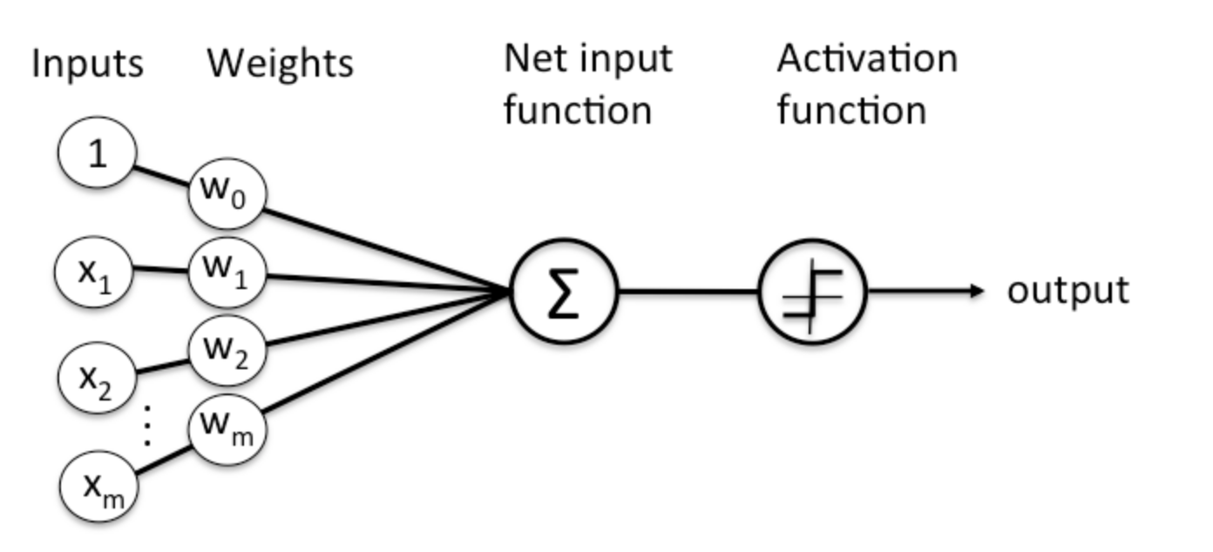
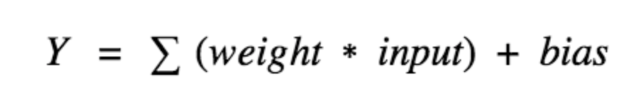
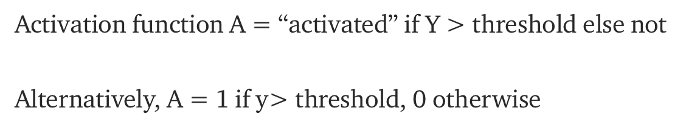
Deep Learning Introduction
Activation of a neuron
The output from the neuron is a real number between 0 and 1
The neural net “learns” by tweaking the weights and biases step by step until the prediction closely matches the correct output, i.e. minimize the “cost value”
Notes:
X - inputs
w_{i} - weights, w1,w2,…, real numbers expressing the importance of the respective inputs to the output
Net input function, sometimes called the bias – bias, a measure of how easy it is to get the neuron to fire; not all incoming information is equally useful; some is just noise;
Bias – popcorn, rain, dog (initialized to be 0, tuned along with the weight with back propagation)
Activation – output between 0 and 1; without the activation function, a neural network is essentially a linear regression model;
- how important a neuron is in the overall classification
Much like a human brain, one of these neurons fire when it encounters a stimuli.

Slide 6
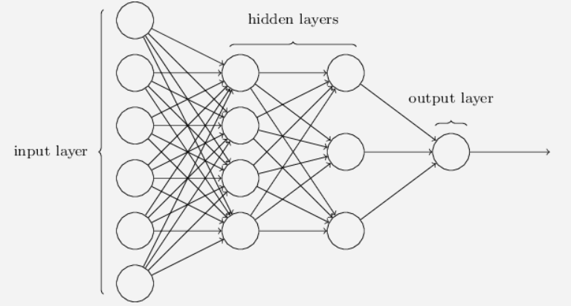
Deep Learning Introduction
Forward Propagation
Scores are passed on as input to the next layer
Input layer: Ingest input values, e.g. pixels of an image, vital statistics of a patient
Output layer: The predicted value. e.g. the category of the image or if the patient is sick
Notes:
Each node in the hidden and output layer has its own classifier
Firing of a classifier, or activation, produces a score
Notice that Every neuron of one layer is connected to each neuron in the adjacent layer
Input layer: something like a pixel of an image or vital statistics of a patient
Output layer: The predicted value. e.g. the category of the image or if the patient is sick
Forward propagation- sums the inputs, produces the activation
Backpropagation is a method used in artificial neural networks to calculate a gradient that is needed in the calculation of the weights to be used in the network.
It is how the neural networks get trained

Slide 7
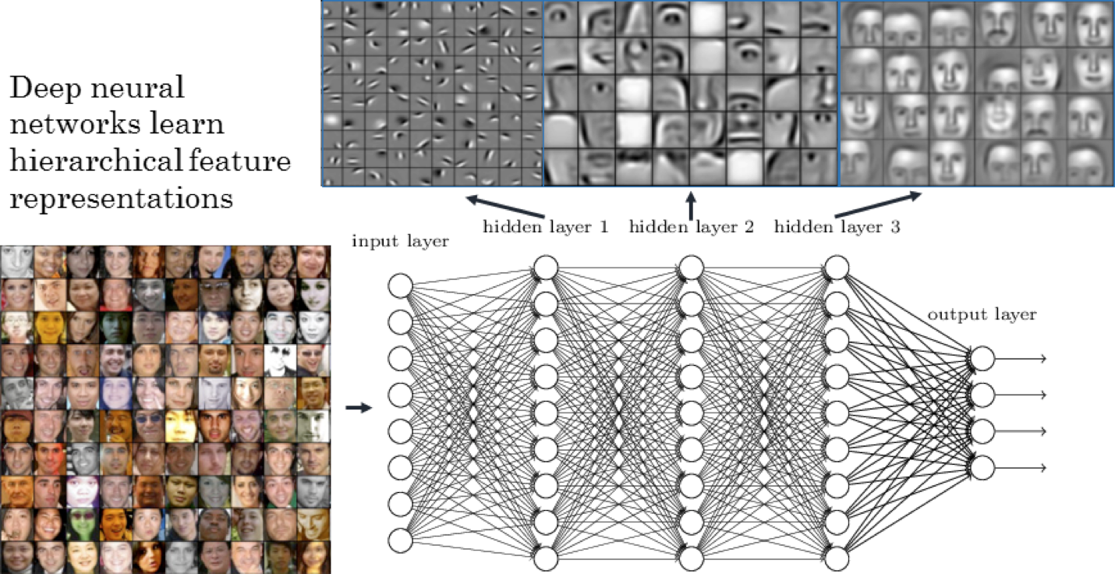
Deep Learning Introduction
Deep Learning algorithms learn “Feature Hierarchies” as they progresses through their hidden layers
Notes:
IF YOU ARE NOT USING DEEP LEARNING ON SOMETHING HIERARCHIAL, it does not make sense.
It has to be something like a pixel in a picture or video analysis
No customer churn, student drop out rate – shallow nets
Deep refers to the number of hidden layers in the neural network; tradition neural nets may have 2-3 hidden layers while deep networks can have as many as 150
One of the most popular types of deep neural nets is the convolutional network (CNN, ConvNet); feature extractions directly from the images by learning to detach features of an image using layers. For example edge detection, and then more complex shapes

Slide 8
Why the need for Deep Learning?

Slide 9
Why Deep Learning? Why now?
DL algorithms learn more complex patterns than is possible with traditional machine learning algorithms
Simple
Moderate
Complex
Pattern Complexity
Basic Classifiers:
Logistic Regression or SVM
Traditional Shallow Neural Network
Deep Net
Increased availability of labelled data
Deep nets take a long time to train
Availability of high performance GPUs speeds up training of a deep net
GPU is approximately 250 times faster than CPU, i.e. the difference between one day of training and over eight months.
Notes:
STORY!!!
Facebook
DL Requires large amounts of labeled data
Deep learning requires substancial computer power
So around the 80’s deep learning was a hot topic; researches has a lot of success with shallow networks
In 2006 a break through made DL possible: algorithms, more data, faster GPU’s and multi-core CPU’s
If you only need to analyze simple patterns, a basic classification tool like an SVM or Logistic Regression is typically good enough.
But when your data has 10s of different inputs or more, neural nets start to win out over the other methods.
As the patterns get even more complex, shallow neural networks can become unusable. The reason is that the number of nodes required in each layer grows exponentially with the number of possible patterns in the data.
Eventually training becomes way too expensive and the accuracy starts to suffer. So for an intricate pattern – like an image of a human face, for example – basic classification engines and shallow neural nets simply aren’t good enough – the only practical choice is a deep net.
Why now?
One of the fascinating things about neural networks is how long they have taken to be an over night success. The history goes back all the way to the 1950s. Deep learning has really only taken off in the last five years. The reason is the increased availability of label data along with the greatly increased computational throughput of modern processors.
For a long time, we didn't have the huge labelled data sets that we needed to make deep learning work. Those data sets only became widely available with the rise of the Internet, which made collecting and labeling huge datasets feasible. But even when we had big datasets, we often didn't have enough computational power to make use of them and it is only been in the last five years that processors have gotten big enough and fast enough to train large scale neural networks.
Shallow neural network – just 1 hidden layer
Deep nets – able to build up a complex hierarchy of concepts

Slide 10

Make me a lego shark!
Notes:
What is the difference between these shallow nets and deep learning
Well imagine I ask you to make me a lego shark…

Slide 11
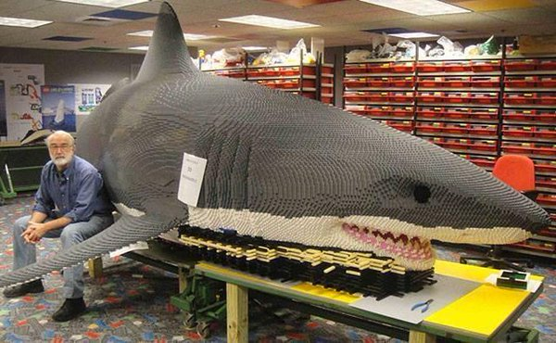
Make me a Lego shark with deep learning
Notes:
Deep learning is a sub field of machine learning
More hidden layers, feature hierarchy to learn
We now see the fills, the gums and teeth of the sharks mouth
It looks like a much realistic shark. Not to say we couldn’t tell what the last lego design was..this is just obviously more detailed

Slide 12
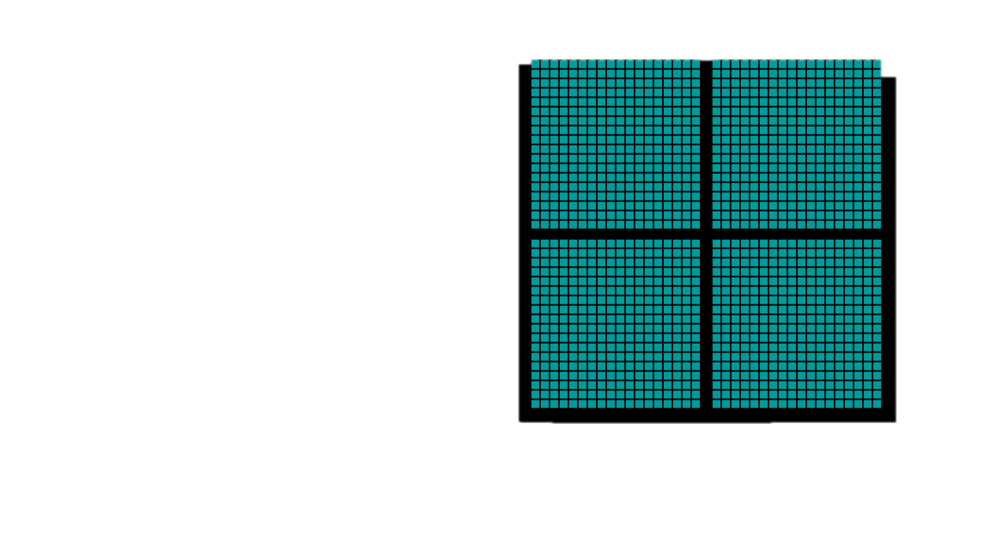
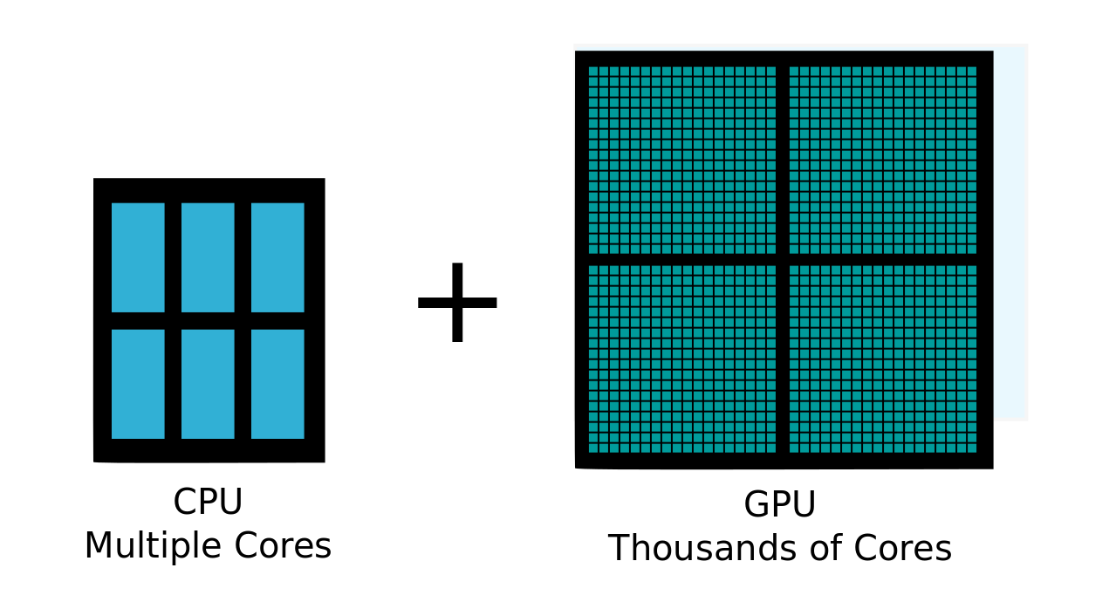
CPUs have multiple cores, whereas GPUs have thousands of cores
https://www.youtube.com/watch?v=-P28LKWTzrI
CPU
Multiple Cores
GPU
Thousands of Cores
Notes:
Originally, GPUs were purpose-built for computational problems in the computer graphics industry

Slide 13
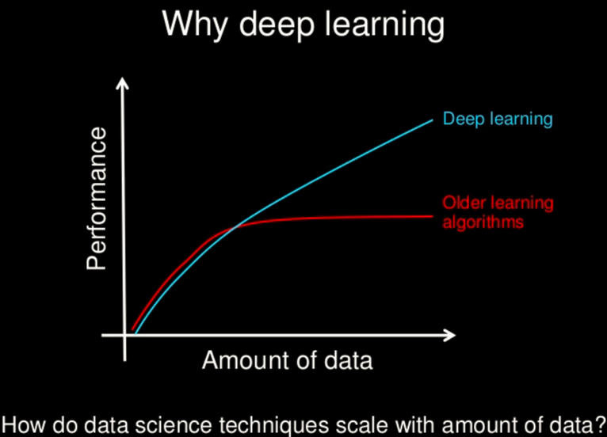
Notes:
for most flavors of the traditional learning algorithms … performance will plateau. … deep learning … is the first class of algorithms … that is scalable. … performance just keeps getting better as you feed them more data
‘
Big legos, cant get more detailed the more legos you give it
The small legos, add detail
https://www.slideshare.net/ExtractConf/andrew-ng-chief-scientist-at-baidu

Slide 14
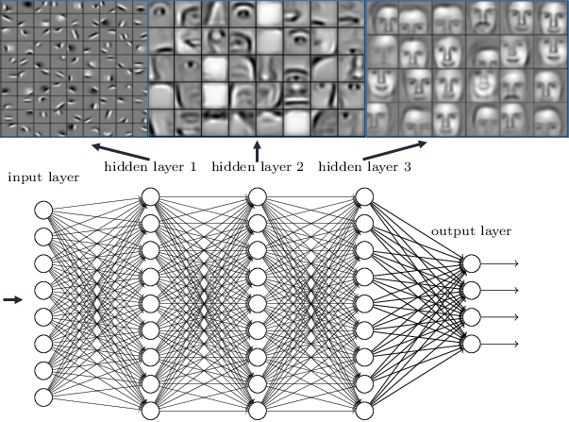
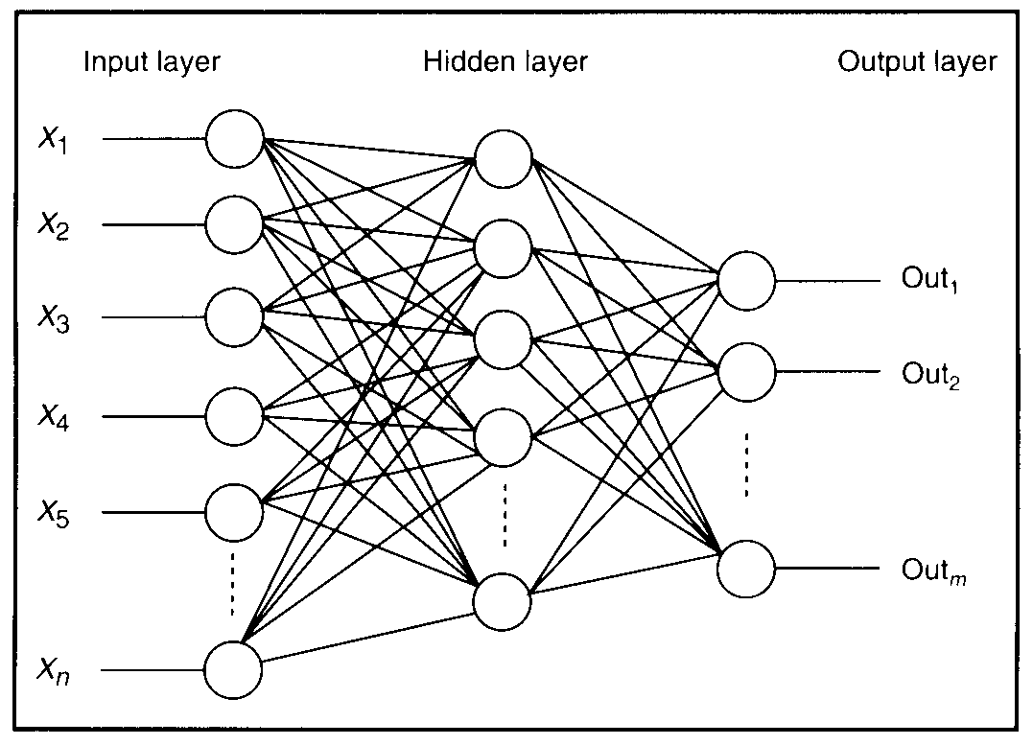
Deep Learning is…
a collection of statistical machine learning techniques
Deep Boltzmann Machine (DBM)
Deep Belief Networks (DBN)
Recurrent Neural Networks (RNN)
Convolutional Neural Networks (CNN), etc.
used to learn feature hierarchies
based on artificial neural networks
Notes:
19
KEY IDEAS OF DEEP LEARNING
Hierarchical non-linear system
Distributed representations
Sharing
End-to-end learning
Joint optimization of features and classifier
Good features are learned as a side product of the
learning process
Not for all businesses and only relevant if there is a hierarchy
Deep learning is a particular kind of machine learning that achieves great power and flexibility by learning to represent the world as nested hierarchy of concepts, with each concept defined in relation to simpler concepts, and more abstract representations computed in terms of less abstract ones
There is no single definition of deep learning, but most definitions emphasize:
Branch of machine learning
Models are graph structures (networks) with multiple layers (deep)
Models are typically non-linear
Both supervised and unsupervised methods are used for fitting models to data

Slide 15
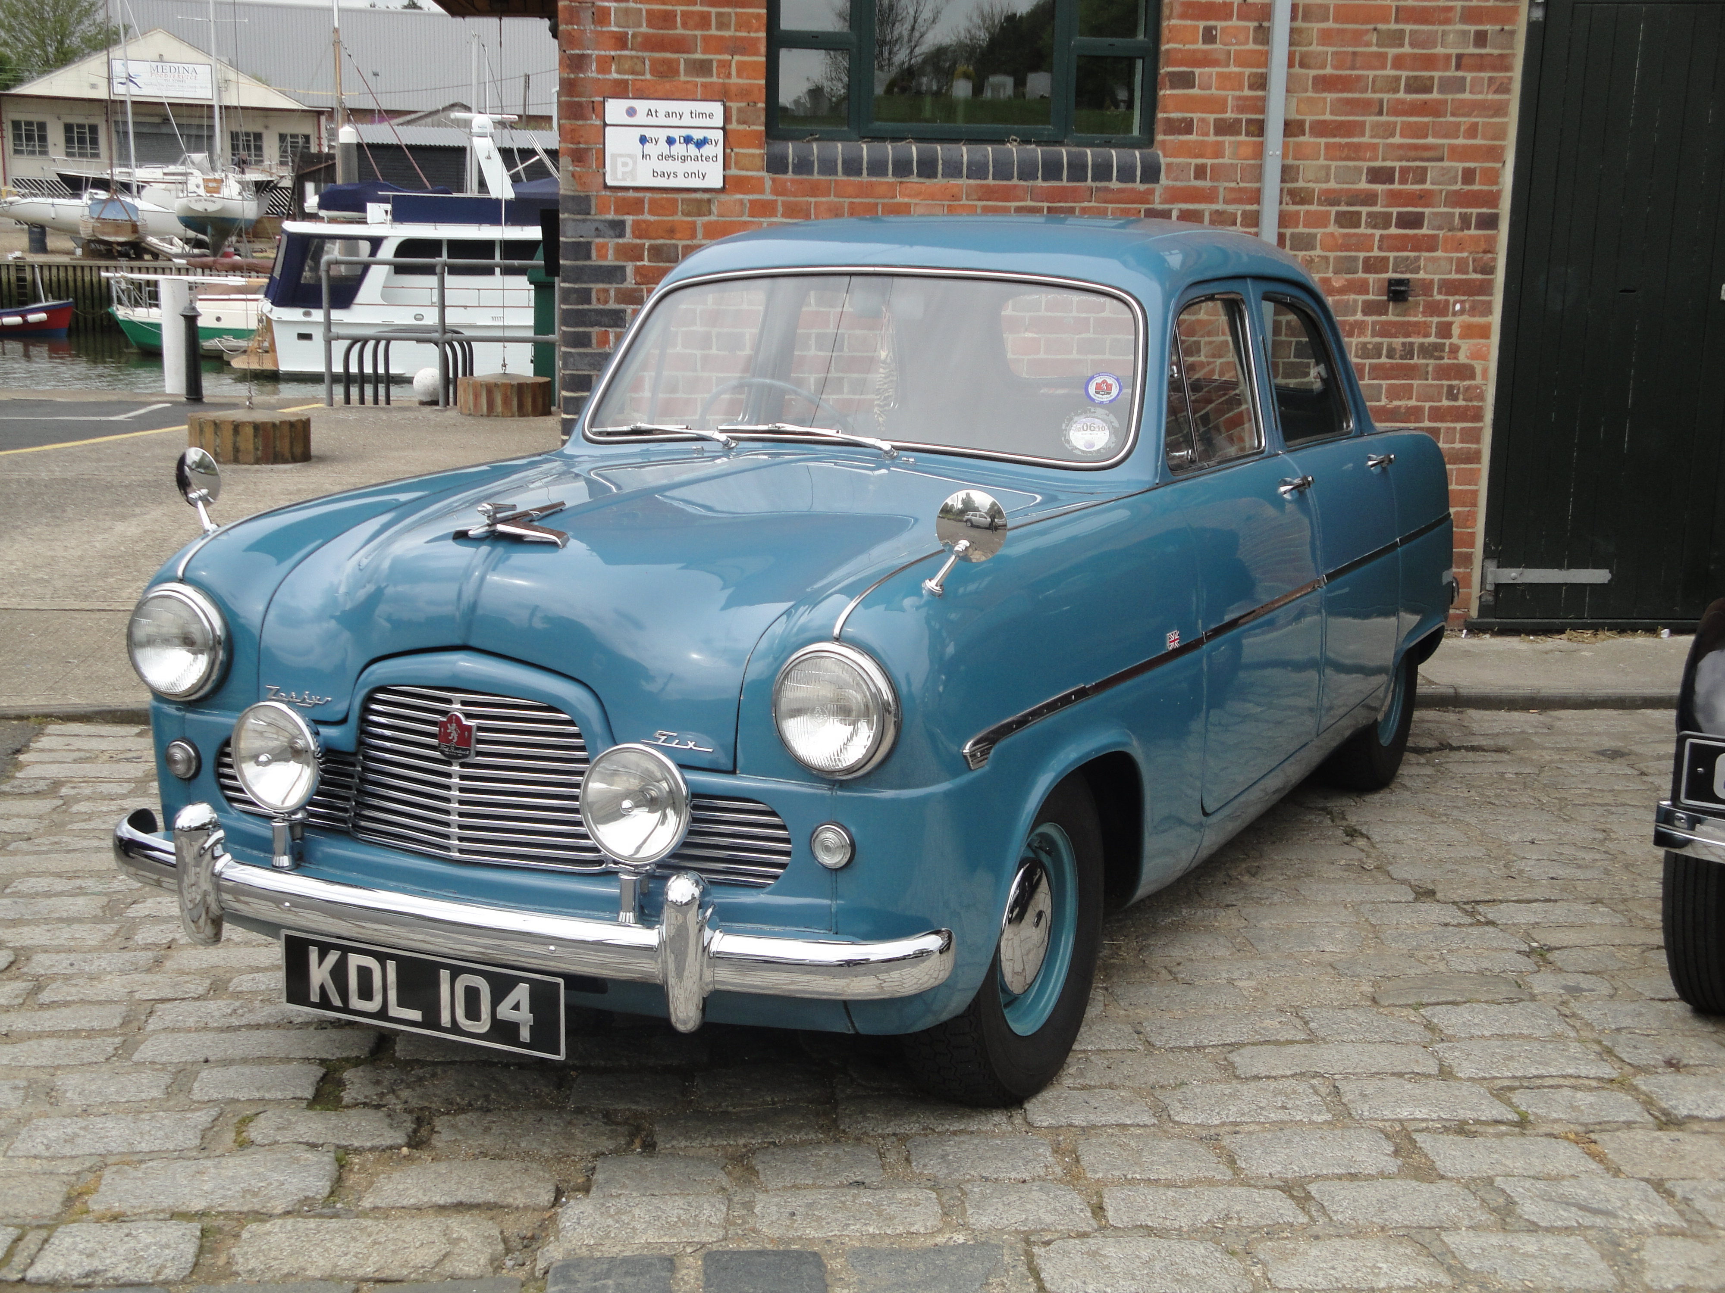
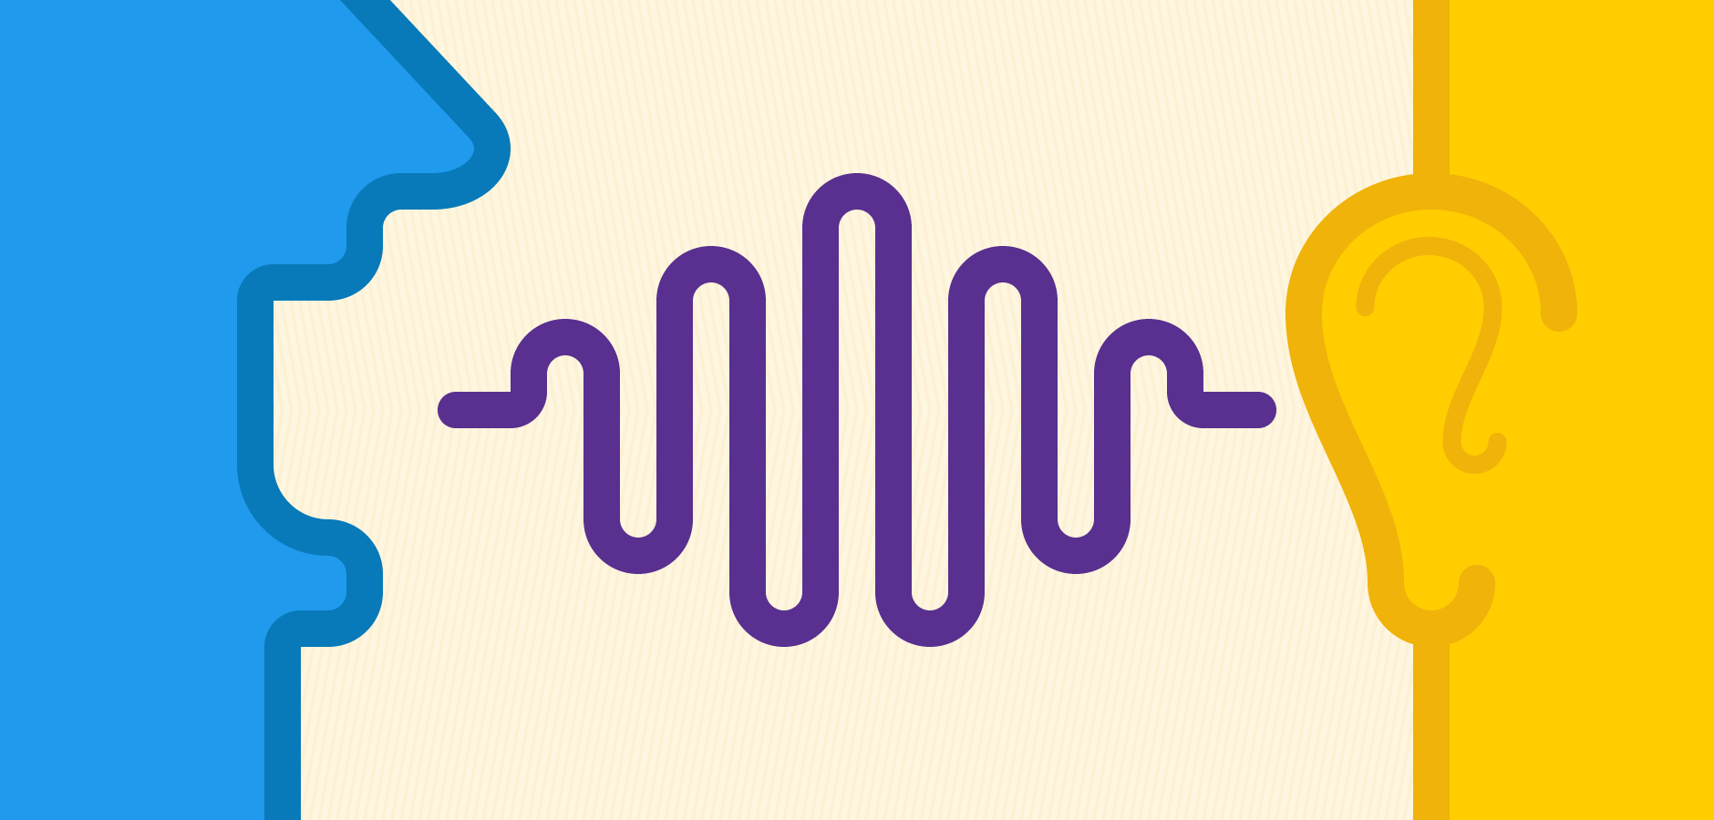
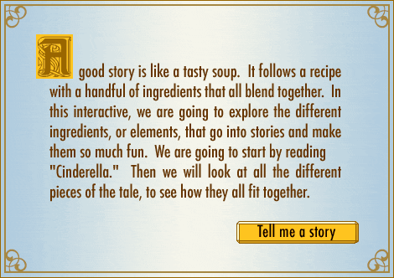
Deep Learning is structured to be effective in problem domains which have an inherently Hierarchical Composition
VISION
pixels -> edge -> texton -> motif -> part -> object
e.g. self-driving cars, reading medical images
SPEECH
sample -> spectral band -> formant -> motif -> phone -> word
e.g. Alexa
NATURAL LANGUAGE PROCESSING
character -> word -> clause -> sentence -> story
e.g. DeepText: Facebook's text understanding engine
Notes:
https://code.facebook.com/posts/181565595577955/introducing-deeptext-facebook-s-text-understanding-engine/
Hierarchy important for classification/categorization - Hot Dog / Not Hot Dog
- often hiercherial classification
Textons refer to fundamental micro-structures in generic natural images and the basic elements in early (pre-attentive) visual perception.
A formant is a concentration of acoustic energy around a particular frequency in the speech wave

Slide 16
Key Differences between traditional “Machine Learning” and “Deep Learning”
 | Machine Learning | Deep Learning
Data Volumes | Can work on small data volumes | Needs large data volumes
Feature Engineering | Needs a lot of data preparation and feature engineering | Feature engineering is implicitly performed during training
Hardware | CPU and/or GPU | Needs accelerators such as GPUs
Model Interpretability | Models are easy to interpret (e.g., Decision Trees) | Difficult to understand why the model produces a given prediction
Notes:
https://www.analyticsvidhya.com/blog/2017/04/comparison-between-deep-learning-machine-learning/
The most important difference between deep learning and traditional machine learning is its performance as the scale of data increases. When the data is small, deep learning algorithms don’t perform that well. This is because deep learning algorithms need a large amount of data to understand it perfectly.
Feature engineering is a process of putting domain knowledge into the creation of feature extractors to reduce the complexity of the data and make patterns more visible to learning algorithms to work. E.g. we extract, day, month, year, duration from a date field to make patterns more “visible”, we reclassify or bin values, or we drop highly correlated fields. Deep learning algorithms try to learn high-level features from data. Like, Convolutional NN will try to learn low-level features such as edges and lines in early layers then parts of faces of people and then high-level representation of a face.
Deep learning algorithms heavily depend on high-end machines with GPUs, contrary to traditional machine learning algorithms, which can work on low-end machines. Deep learning algorithms inherently do a large amount of matrix multiplication operations, which GPUs are designed to do.
Machine learning algorithms like decision trees give us crisp rules as to why it chose what it chose, so it is particularly easy to interpret the reasoning behind it. Therefore, algorithms like decision trees and linear/logistic regression are primarily used in industry for interpretability.

Slide 17
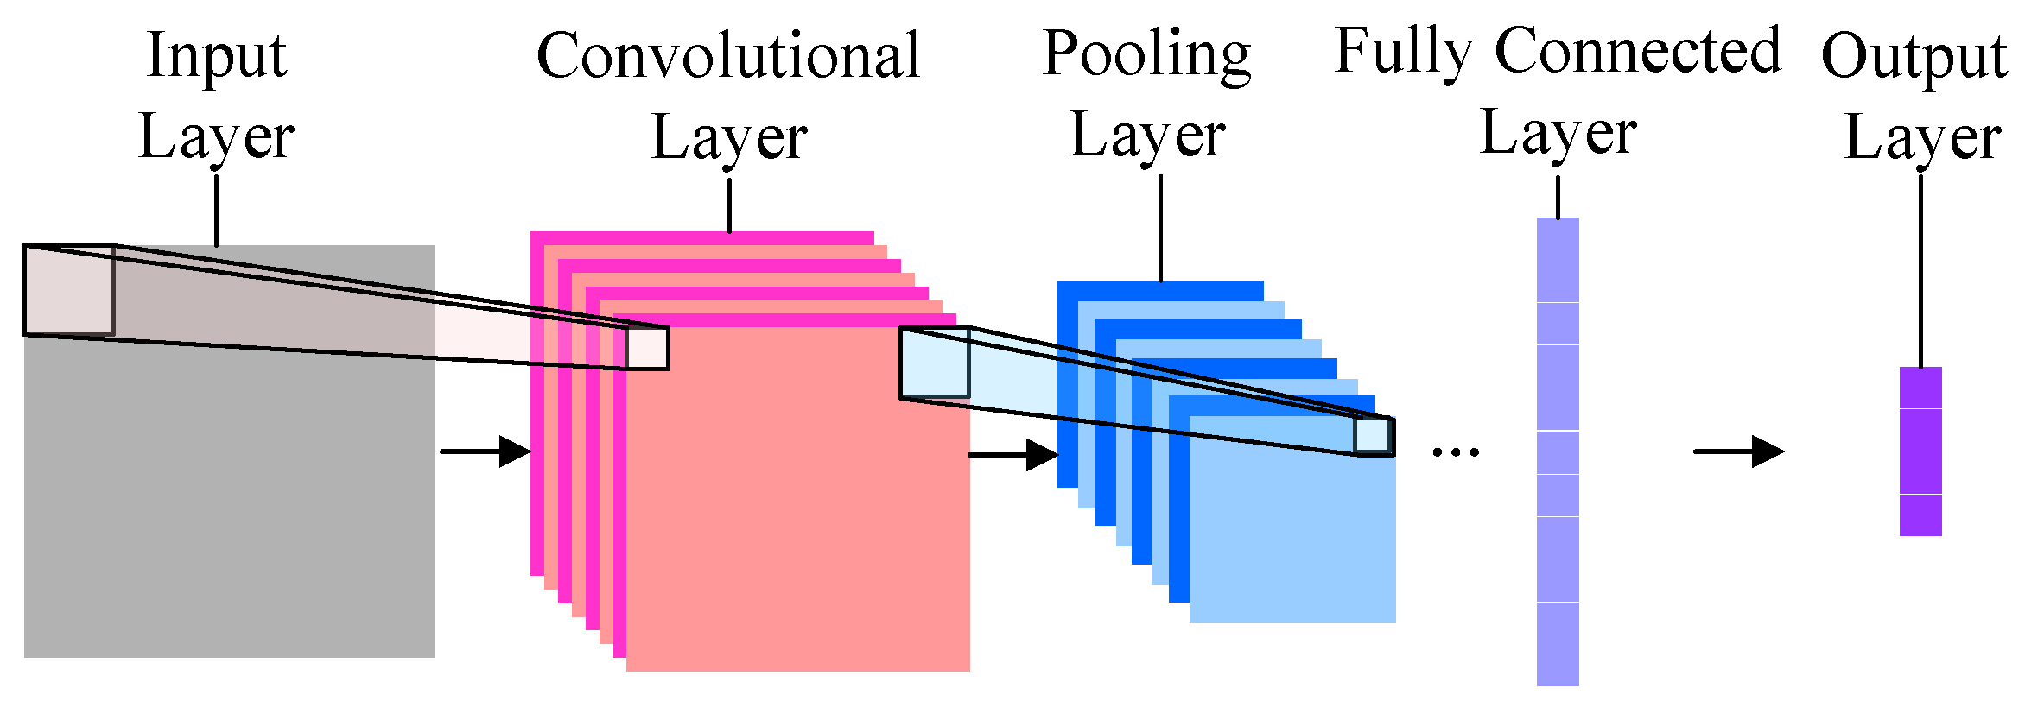
Convolutional Neural Networks
Notes:
Max pooling: finding keys
A convolutional neural network can have tens or hundreds of layers that each learn to detect different features of an image. Filters are applied to each training image at different resolutions, and the output of each convolved image is used as the input to the next layer. The filters can start as very simple features, such as brightness and edges, and increase in complexity to features that uniquely define the object as the layers progress.
https://www.mathworks.com/discovery/convolutional-neural-network.html

Slide 18
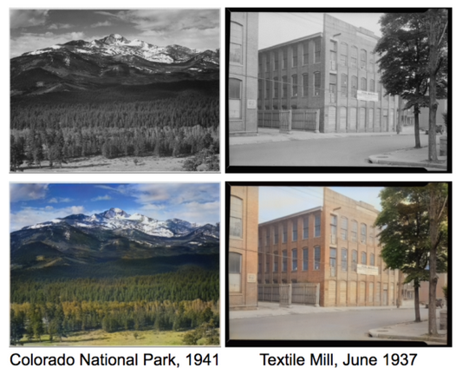
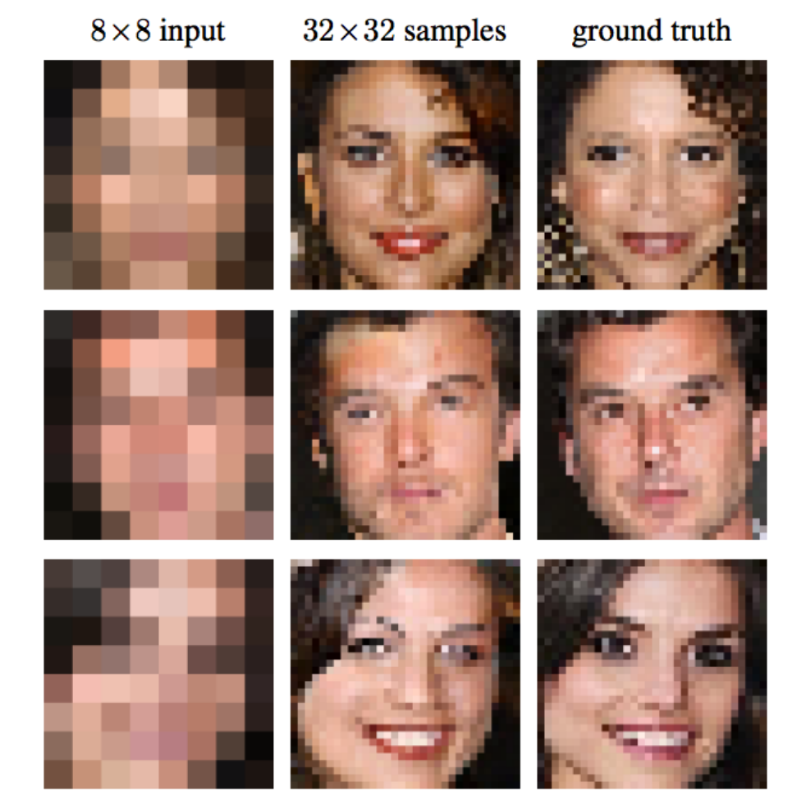
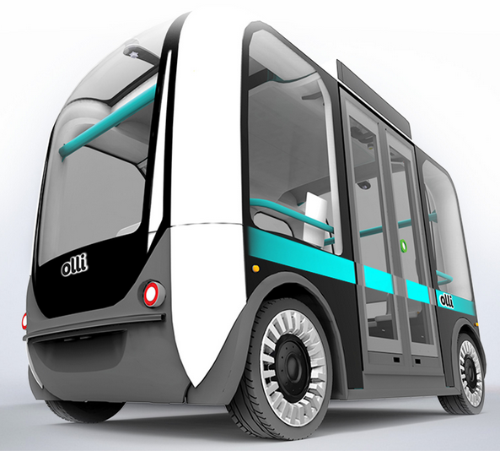
Use Cases
Restore Colors to B/W Photos
Pixel Restoration: CSI Style
Self Driving Cars
Notes:
Color Restoration → black and white photos (old fashion) to turn into color; The Deep Learning network actually learned patterns that naturally occur in photos - the sky is usually blue, clouds are often white/gray and grass is typically green in order to restore these colors. But it did so itself from its past experience without human intervention.
Pixels: Well, it was unrealistic until Deep Learning. Early in 2017, Google Brain researchers trained a Deep Learning network to take very low resolution images of faces and predict what each face most likely looks like. They call the method Pixel Recursive Super Resolution which enhances resolution of photos significantly. In the image below you can see the original 8x8 photos, the ground truth (which was the real face originally in the photos) and in the middle the guess of the computer. Obviously it is not perfect, as it cannot be, but it is pretty unbelievable that the computer can guesstimate so well many of the features of the person in the photo.
http://www.yaronhadad.com/deep-learning-most-amazing-applications/
Other: Netflix: Visual recognition: pick up on cues such as introductions; the “Skip intro button” based on repeated pattern in episodes
https://www.marketwatch.com/story/netflix-uses-frame-by-frame-machine-learning-to-decide-what-you-really-want-to-watch-2017-09-27
Self driving cars

Slide 19
Popular Machine Learning Frameworks
Tensorflow
Keras
Caffe
PyTorch

Slide 20
AI Requires Teamwork
Watson Studio: accelerating value from AI for enterprises
Watson Studio accelerates the machine and deep learning workflows required to infuse AI into your business to drive innovation. It provides a suite of tools for data scientists, application developers and subject matter experts to collaboratively and easily work with data and use that data to build, train and deploy models at scale.
AI is not magic
AI is algorithms + data + team

Slide 21




Watson Studio
Built for AI teams – enabling team productivity and collaboration
Tanya
Domain Expert
Mike
Data Scientist
Ed
Data Engineer
Deb
The Developer
Her Job:
To transfer knowledge to Watson for a successful user experience.
His Job:
Transform data into knowledge for solving business problems.
His Job:
Architects how data is organized and ensures operability
Her Job:
Builds AI application that meet the requirements of the business.
What she does:
Range of domain knowledge and uses that to teach Watson and develop a custom models
As Tanya gains more experience she optimizes her knowledge to teach Watson to design better end-user experiences.
What he does:
Runs experiments to build custom models that solve business problems.
Use techniques such as Machine Learning or Deep Learning and works with Tanya to validate success of trained models.
What he does:
Builds data infrastructure and ETL pipelines. Works with Spark, Hadoop, and HDFS.
Works with data scientist to transform research models into production quality systems.
What she does:
Starts PoCs which includes gathering content, dialog building and model training
Focus is on app building for the team or company to use. Will handle ML Ops as needed
Sometimes known as:
Subject matter expert, content strategist.
Sometimes known as:
ML/DL engineer, Modeler, Data Miner
Sometimes known as:
Data infrastructure engineer
Sometimes known as:
Front-end, back-end, full stack, mobile or low-code developer

Slide 22
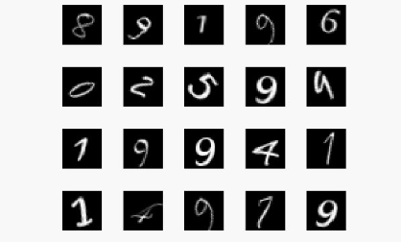
Deep Learning Lab Exercise- MNIST Dataset
For the lab, you will be using the the MNIST dataset of handwritten digits 0-9
This dataset contains 60,000 images and will be used for training our model

Slide 23
Deep Learning Lab Exercise Flow
Setup Watson Studio Environment
Create a Model with NN Modeler
Train the model with Experiment Builder
Deploy the model
Deploy the Tensorflow Model
Use HPOs to train and compare multiple conditions
Import a TensorFlow Model
http://bit.ly/2smqznW

Slide 24

Survey
http://bit.ly/WPLdc053118

